Slide 1
How does the web work? Definition: The web is a global network of interconnected computers, accessed through web browsers. It enables the sharing of information, services, and multimedia content, fostering global communication and collaboration. Standardized protocols like HTTP facilitate data transfer on the web.

Slide 2
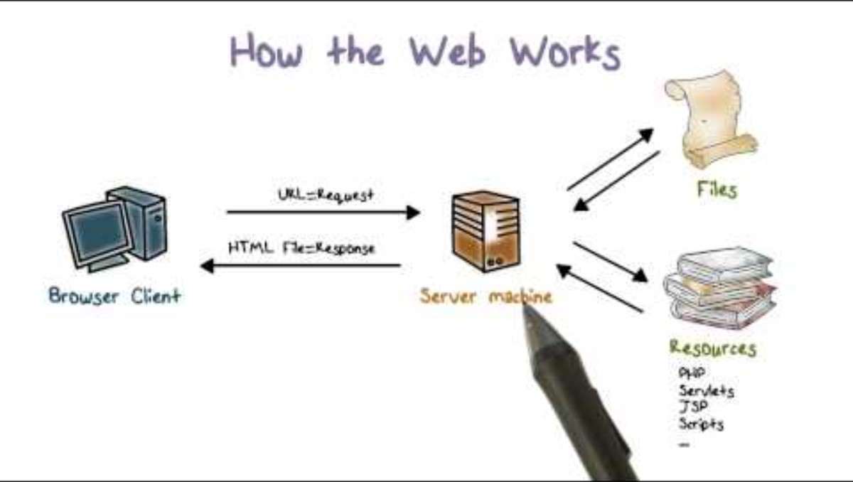

Slide 3
What do you need to be a web developer? To become a web developer, you typically need the following:
A strong foundation in programming languages such as HTML, CSS, and JavaScript.
Knowledge of web development frameworks and libraries (e.g., React, Angular, Vue.js).
Understanding of server-side languages like Node.js, Python, Ruby, or PHP.
Familiarity with databases (e.g., MySQL, MongoDB) and version control systems (e.g., Git).

Slide 4
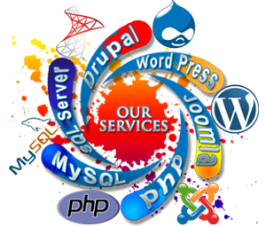

Slide 5
